Slide 1
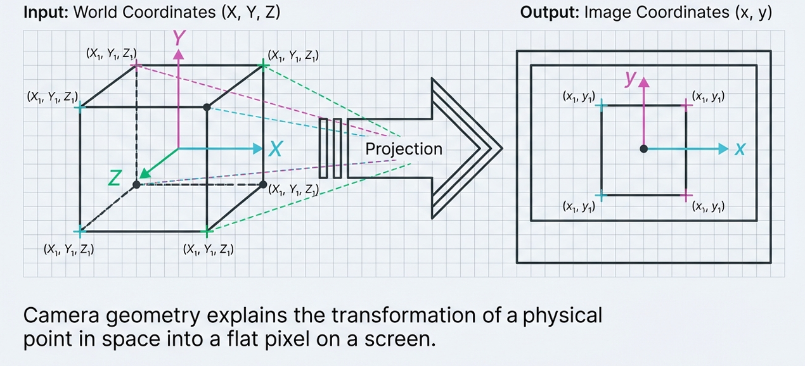
The world is 3D. The image is 2D.

Slide 2
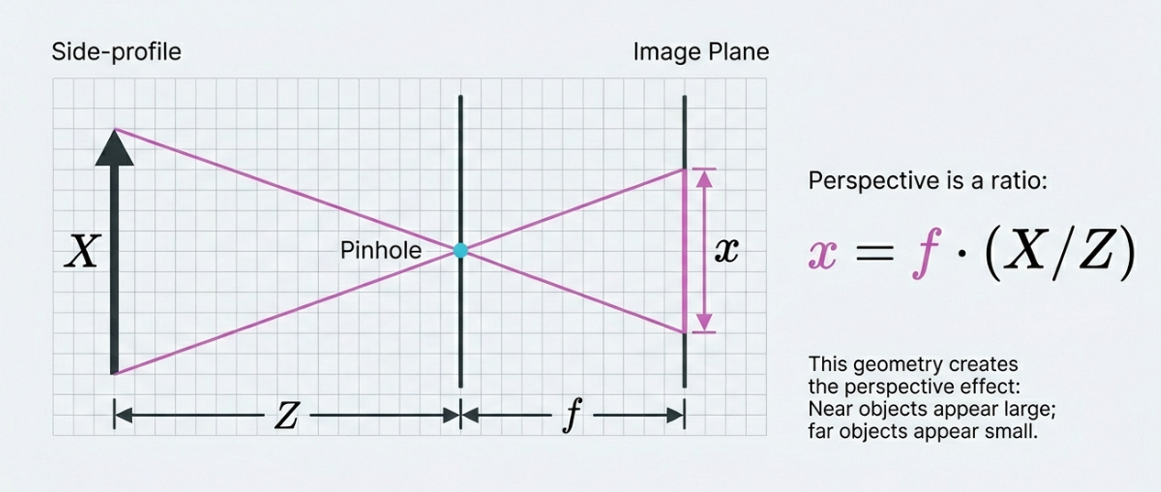
The Pinhole Model

Slide 3
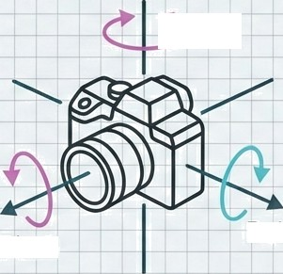
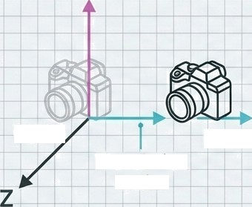
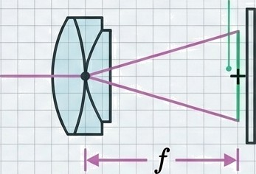
Three factors define a camera
Position Rotation
Intrinsics
Yaw
Sensor center
(0,0,0),
(1,0,0)
Translation
vector
Roll
Pitch
Where is it?
(Translation vector)
Which way is it looking?
(Orientation matrix)
Internal settings
(Focal length, sensor center)
Together, these parameters dictate exactly how a 3D point lands on a specific pixel.

Slide 4
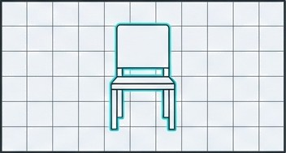
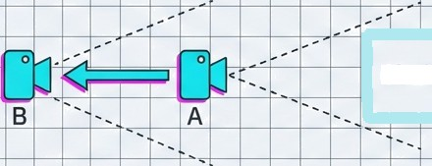
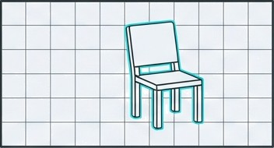
Position dictates perspective
Imagine taking a photo of a chair, stepping to the left, and taking another. The chair moves in the frame because the camera's position in the 3D world changed.
Top-Down View (3D Space) Camera View
Chair
View from A
View from B

Slide 5
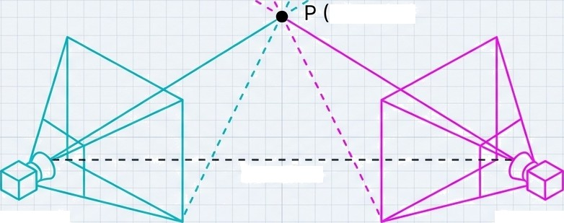
“The Second Eye"
3D Point)
Baseline
Camera A Camera B
To understand depth, we need two perspectives. Epipolar geometry describes the mathematical relationship between these two cameras.
Key Question: If we find a feature (like a table corner) in Image A, where do we look for it in Ima e B?

Slide 6
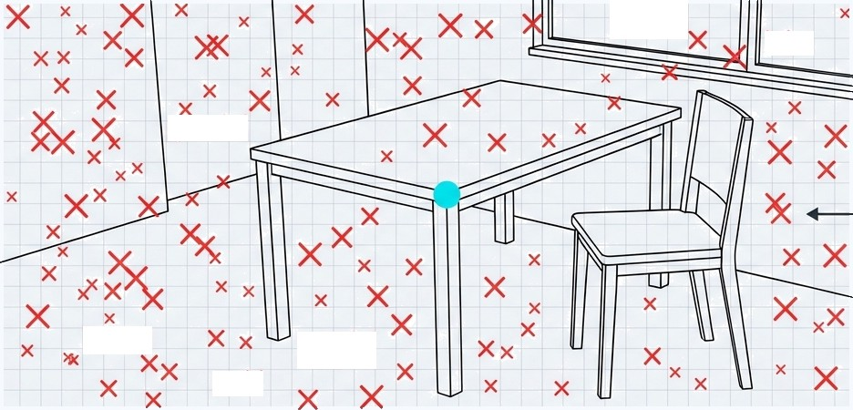

The Matching Problem
Suppose you see a table corner in the left image. Without geometry, finding that same corner in the right image requires searching every single pixel.
_{X}X X _{x}
S X
Naive Search: Slow, prone to mistakes.
X_{X} X
_{X}X

Slide 7
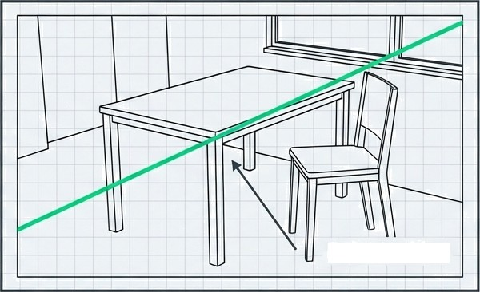
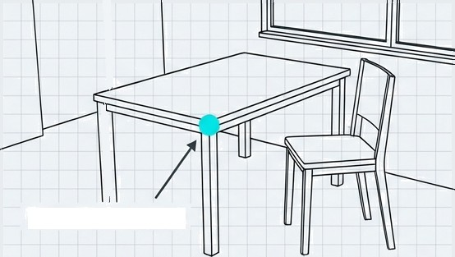
The Epipolar Constraint
Image A (Left View)
Image B (Right View)
Point in Image A
Epipolar Line
Point in Image A —> Line in Image B
Epipolar geometry proves that a point in Image 1 corresponds to a specific line in Image 2. The match MUST be on this line.

Slide 8
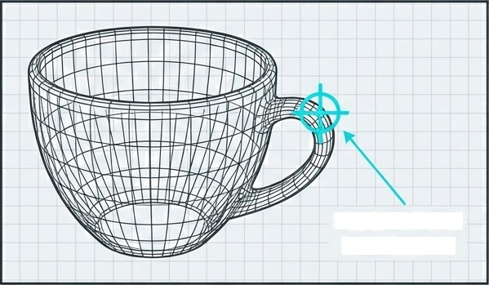
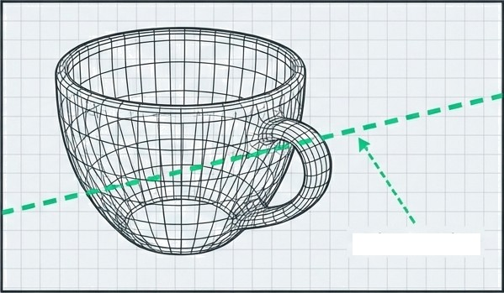
Reducing the search space
Lek View
Right View
Marked Point in Left View
Epipolar Line
If we mark the cup's handle in the left image, it mnst appear on the epipolar line in the right image. It cannot be above or below it.
Result: We stop searching the whole image and only search the line.

Slide 9
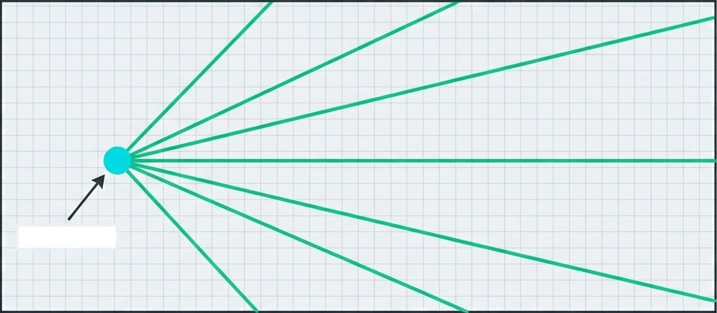
The Epipole
e (Epipole)
The epipole is simply the point in the image where the other camera is visible. All epipolar lines pass through this single convergence point.
Think of it as the vanishing point of the other camera.

Slide 10
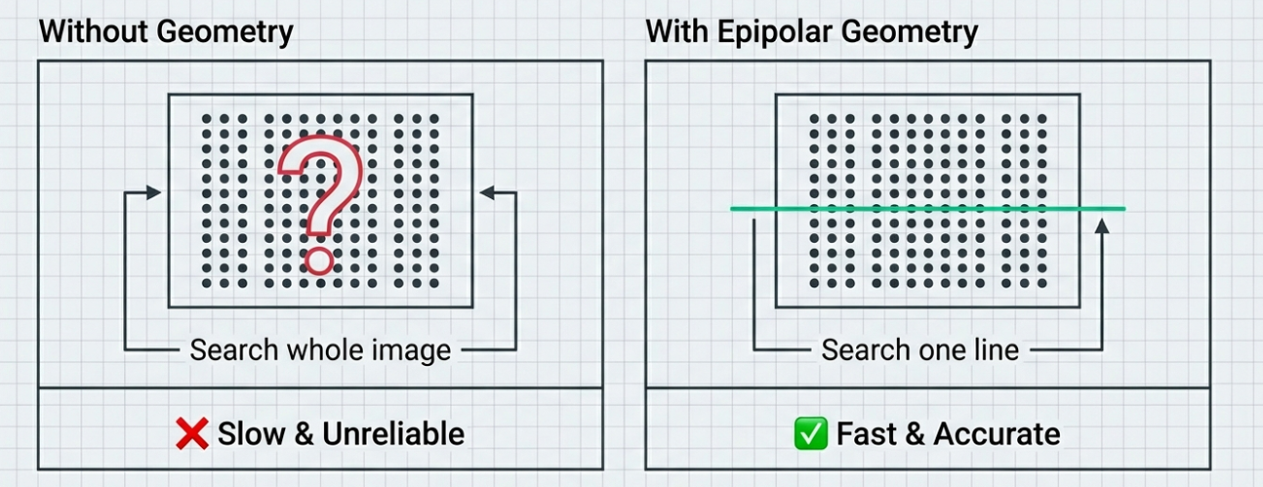
Why this geometry matters
Constraining the search makes stereo vision computationally feasible and
significantly more reliable for depth estimation.

Slide 11
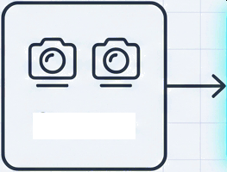
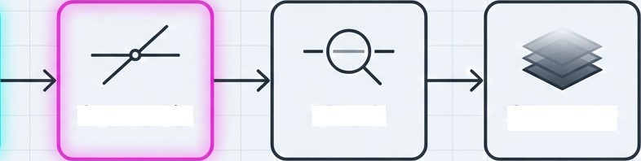


The Stereo Vision Pipeline
Capture
Calibrate
Constrain
Match
Compute
Geometry Applied Here

Slide 12
